Slide 1
Week 4 Workshop
Web Development Fundamentals
HTML, CSS, and JavaScript

Slide 2

Agenda
Activity​​ | Time​​ | ~Start
Get Prepared: Log in to Nucamp Learning Portal • Slack • Screenshare​​ | 10 minutes​​ | 9:00am
Check-In​​ | 10 minutes​​ | 9:10am
Week 4 Recap​​ | 60 minutes​​ | 9:20am
Tasks 1​ & 2 | 40 minutes​​ | 10:20am
BREAK​​ | 15 minutes​​ | 11:00am
Tasks 2-4 | 90 minutes​​ | 11:15am
Check-Out​​ | 15 minutes​​ | 12:45pm

Slide 3
Week 4 Recap - Overview
For Loops For ... Of Loops Break & Continue More Array Methods More About Strings String Methods The HTML DOM Locating Nodes Creating & Adding Nodes | Adding Nodes Removing Nodes Cloning Nodes Inline OnEvent Handlers Mouse Events setTimeout() & setInterval() clearTimeout() & clearInterval() addEventListener() removeEventListener()

Slide 4
Check-In
How was this week for you? Any particular challenges or accomplishments?
Did you understand the Exercises and were you able to complete them?
How were the Challenges and Quiz this week?
We know that this was a difficult week for many. Please ask if you have questions.

Slide 5
For Loops
For loops have built-in support to set a variable to iterate for the loop condition:
Discuss: What would the above loop log to the console? Do you understand why?
Note: the statement x = x * i; could also be written more simply as: x *= i;
let x = 5; for (let i = 1; i <= 3; i++) { x = x * i; console.log(x); }
Output:
5
10
30
Type it into your console to try it out.

Slide 6
For … Of Loops
for … of loops can be used with arrays and other iterables in JavaScript.
Discuss: What would the above loop log to the console? Do you understand why?
const exampleArray = [2, 4, 6, 8];
for (const n of exampleArray) { console.log(n * 2); }
Output:
4
8
12
16
Type it into your console to try it out.

Slide 7
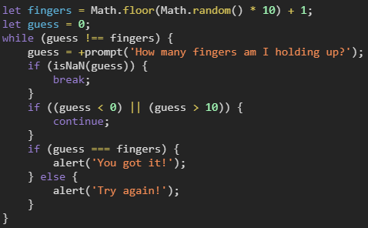
Break & Continue
Use in any for or while loop to break out of the loop entirely (break), or skip the current iteration (continue).
Given the code to the right, what is the response if you enter a guess of –1 when prompted?
What about a guess of true?
This will jump/continue to the top of the while loop and prompt the user again
prompt() returns a String so when true is passed this will result in the string "true". The "+" operator then tries to convert it to a Number which it then results in NaN since it doesn't contain a number wrapped in a string (e.g. "1"). It will then break out of the loop.

Slide 8
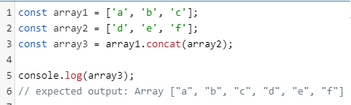
More Array Methods
concat() - combine two arrays into one
Does NOT mutate the original array
sort() - sort an array of strings alphabetically
Mutates the original array
Note: When using numbers with sort(), results may not be what you expect.
[1, 13, 1000, 29, 255].sort() would result in this array:
[1, 1000, 13, 255, 29]
NOT [1, 13, 29, 255, 1000] as you might expect
reverse() reverses the order of an array
Mutates the original array

Slide 9

More Array Methods (cont)
slice() - copy a part of an array and return a new array – this does not mutate the original array
splice() - inserts, replaces, or removes parts of an array – this mutates the original array!
If you run this code:
The variable newBirds now holds the array: ['hawk', 'owl'] The array in the variable birds remains the same.
If you then ran the code:
The variable newBirds now holds the array: [hawk, 'owl', 'goose'] The array in the variable birds is now only: ['crow']
slice – think COPY
splice – think CUT
Slice and splice look very similar and do somewhat similar things, but they work very differently so be careful with them.

Slide 10
More About Strings
Strings are not arrays but in some ways work similarly to arrays
You can access each character in a string by its index, as if each character is an item in an array –
'hello'[0] is 'h'
'hello'[1] is 'e'
etc
And you can get the length of a string with .length:
'hello'.length is 5
Discuss: Given this variable:
Can you change myStr's value from 'dog' to 'zog' using the code as follows?:

Slide 11
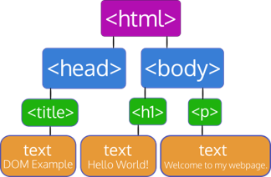
HTML DOM & Node Relationships
What node is the parentNode of <head>?
What node is the nextSibling of <h1>?
What node is the previousSibling of <p>?
What node is the firstChild of <body>?
What node is the lastChild of <html>?
Let's review the DOM:
HTML
P
H1
H1
BODY

Slide 12
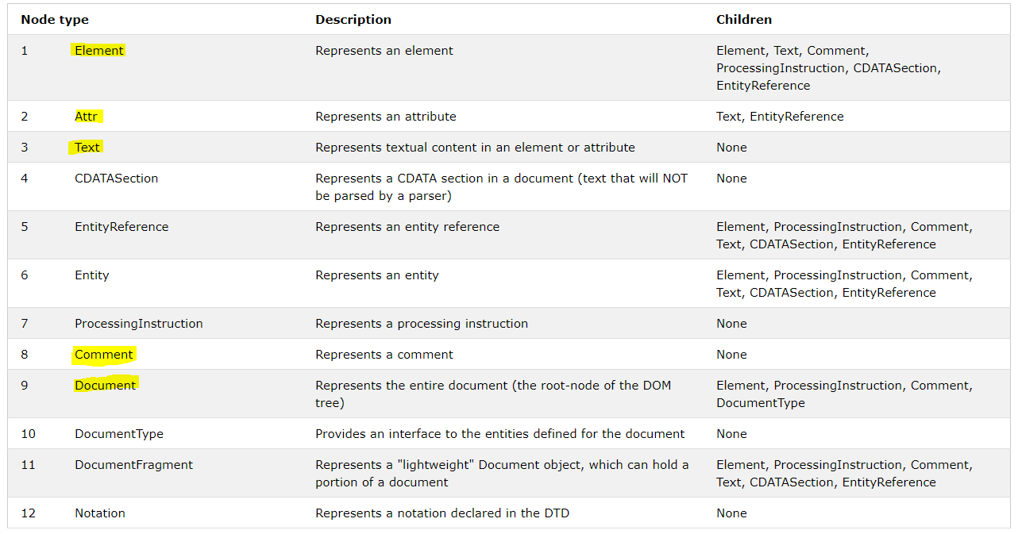
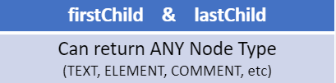
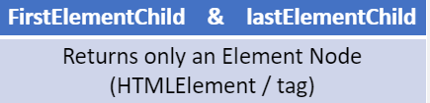
More Node Relationships
Discuss: What is the difference between firstChild and firstElementChild, and lastChild and lastElementChild?

Slide 13
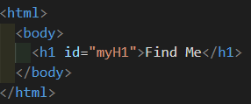
Locating Nodes
Given this HTML:
Discuss: Which of the following ways will correctly find this node?
document.getElementsByTagName('h1');
document.getElementById('myH1')
document.querySelector('myH1')
"B" is the correct answer
"A" would not work as it will return an array. The below would have worked
document.getElementsByTagName('h1')[0];
"C" would not work because the querySelector expects the argument to be in the form of a CSS Selector The below would have worked
document.querySelector('#myH1')

Slide 14
Creating and Adding Nodes
To create a new element node in JavaScript, use document.createElement('elementname')
e.g. document.createElement('div');
To create a new text node, use document.createTextNode('your text')
e.g. document.createTextNode('Hello World');
Once you have created a new node, it isn't part of the DOM yet, you must add it to the DOM using a node method such as node.appendChild() or node.insertBefore()

Slide 15
Removing Nodes
Two ways to remove nodes:
node.removeChild(child node to remove)
node.remove()
Example – let's say you have this HTML:
And this JavaScript:
If you did this:
// This would remove the entire <p> element and its child <img>.
If you did this:
// This would remove just the <img> element.

Slide 16

Removing Nodes
Use a while loop to remove all the child nodes of a parent node without removing the parent node:
Discuss: Are there any volunteers who would like to try to walk through and explain the above code in their own words?
Repeat the loop as long as node.firstChild comes back with a truthy value (meaning there is at least one child node).
Inside the loop, remove the first child node only, then start the loop again.
Once node.firstChild comes back with a falsy value (e.g. null) that means there are no more child nodes left, so exit the loop

Slide 17
Cloning Nodes
Discuss: What is the difference between using node.cloneNode() and node.cloneNode(true)?
node.clone() | Clones only the node itself
node.clone(true) | Clones the node as well as the node branch (descendant nodes)

Slide 18
Inline OnEvent Handlers
There are various events in JavaScript such as click, mouseover, etc
You can set functions to respond to these events, these are called event handler functions, or just event handlers
To set an inline event handler in HTML, you use the name of the event such as 'click', add 'on' to it – so 'onclick', 'onmouseover', etc
Then you use it as an attribute in an HTML element:
Give the function to run as the attribute value, use quotes around it and include the argument list, e.g. "runThisFunction()"

Slide 19
Mouse Events
You learned these inline on-event handlers for mouse events:
onclick
onmousedown
onmouseup
onmouseover
onmouseout
Discuss: What's the difference between onmousedown and onclick?
onmousedown will trigger as soon as either the left or right (or middle) is pressed.
onclick will only trigger when the left mouse button is pressed and released on the same object.

Slide 20
setTimeout() & setInterval()
Set timer events in JavaScript to delay the execution of a function for a given length of time
setTimeout() calls a function once after the time has run out
setInterval() calls a function repeatedly, resetting the clock once the time runs out
You call each the same way: the first argument is a function name, the second is a time in milliseconds:
setTimeout(doSomething, 10000); // will call doSomething() in 10 seconds
setInterval(doSomething, 10000); // will call doSomething(() every 10 seconds

Slide 21
clearTimeout() & clearInterval
setTimeout() and setInterval() both return a unique timer ID as their return value when you call them
Save these return values to a variable so that you can use them to clear the timer if necessary. Otherwise you have no way to stop the timer if you need to. E.g.:
let timerID = setInterval(doSomething, 10000);
clearInterval(timerID); // stop the interval timer

Slide 22
addEventListener
addEventListener() is the recommended way in vanilla JS to add event handler functions to events
Example: You want to have a button respond to clicks by calling a function named doSomething. You have the button node in a variable called btnNode already. You can do this:
Note: No 'on' prefix! It's 'click' and not 'onclick'
The event name goes inside quotes, single or double
The function name does NOT go inside quotes, and you don't include the argument list – it's just doSomething, not 'doSomething' or doSomething()
Remember: addEventListener can be used with the same event, on the same node, more than once.
onevent Handlers like onclick can only be used once per element

Slide 23
removeEventListener()
Use just like addEventListener() to remove an event handler function from an event
So if you used this to add an event handler function to an event:
btnNode.addEventListener('click', doSomething);
You can use this to remove it:
btnNode.removeEventListener('click', doSomething);

Slide 24

Questions during this week tasks?
If we have extra time before the Workshop then feel free to bring up any unresolved questions, and to discuss any Challenge Questions or Code Challenges.
Otherwise, please start the Workshop Assignment and save the discussion for after the assignment is finished, or online.

Slide 25
Workshop Assignment
It's time to start the workshop assignment!
Break out into groups of 2-3.
Sit near your workshop partner(s) in in person
For online Workshops your instructor may break you out into different virtual rooms
Work closely with each other.
Don't forget that the 20-minute rule becomes the 10-minute rule during workshops!
10-minute rule does not apply to talking to your partner(s). Work together throughout. This will be useful practice for working with teams in real life.
Follow the workshop instructions very closely.
Talk to your instructor if any of the instructions are unclear to you.

Slide 26
Assignment Submission & Check-Out
Submit the matching-game.html page at the bottom of the assignment page in the learning portal.
Example instruction on the next slide

Slide 27
Congratulations!!!

Slide 28

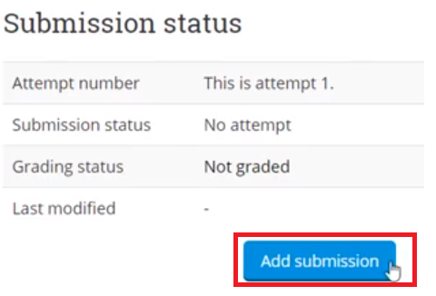
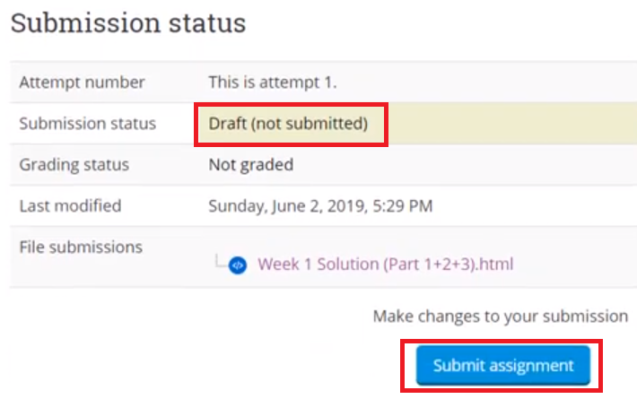
Submitting Your Assignment
Go to https://learn.nucamp.co
Click "Workshop Assignment: Students' Work"
Upload your work by clicking "Add Submission", select the file, and then click "save"
Note that your work is in Draft status
Click "Submit assignment" to submit it

